Slide 1
Assignment 7
Katie Hawthorne

Slide 2
Unfortunately, this collection of screenshots will be less amusing.

Slide 3
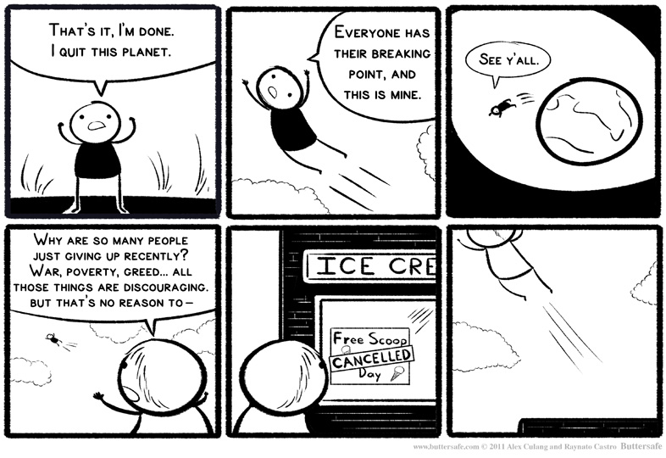
So, I bestow upon you, a comic.

Slide 4
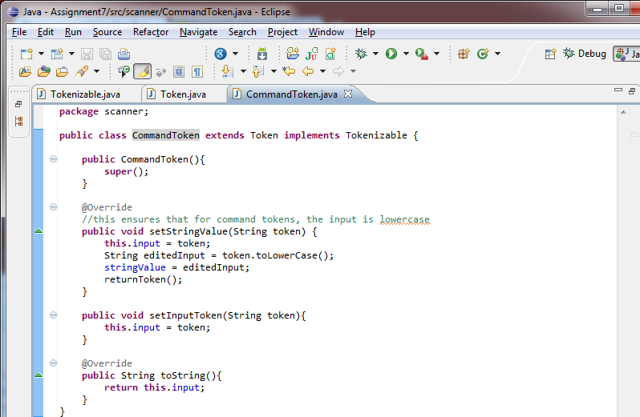
Refactor Token type hierarchy to follow inheritance rules.

Slide 5
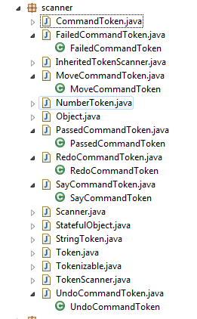
Add additional classes for the following commands: move, say, passed, failed, undo, and redo.
Just so you know, they are all pretty much empty classes that just inherit from Command token, since they don’t do anything unique *yet*. I’m assuming the next assignment they’ll get additional methods unique to them.

Slide 6
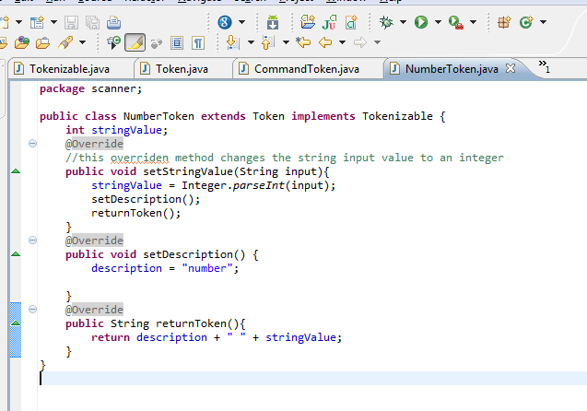
Add a method to the Number token class to return its value as an int.

Slide 7
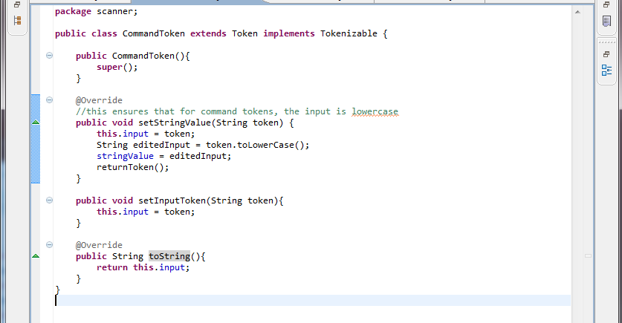
Override the toString() method.
Input is the string token from the array. StringValue is the edited version.
toString returns the original input.

Slide 8
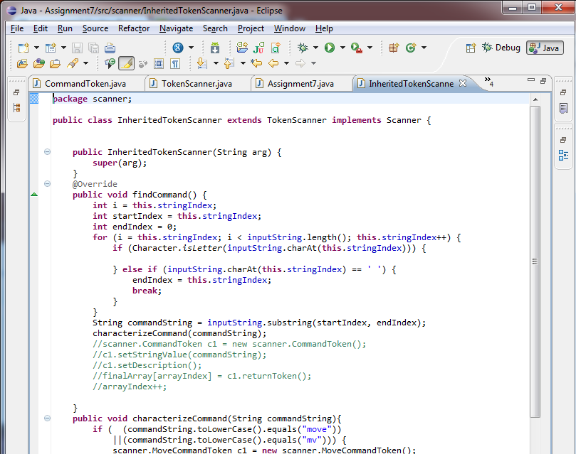
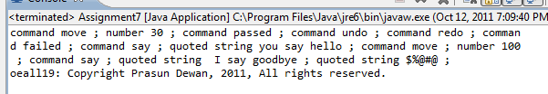
Create a subclass of the stateful scanner class that instantiates the new token classes you have added

Slide 9
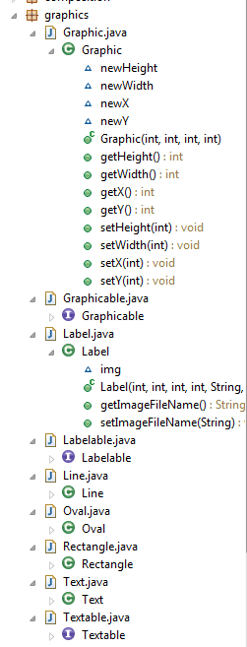
Refactor the graphics classes of assignment 5 to follow the inheritance rules.
public class Graphic implements Graphicable {
public class Rectangle extends Graphic implements Graphicable {
public class Text extends Graphic implements Textable {
public class Label extends Text implements Labelable {

Slide 10
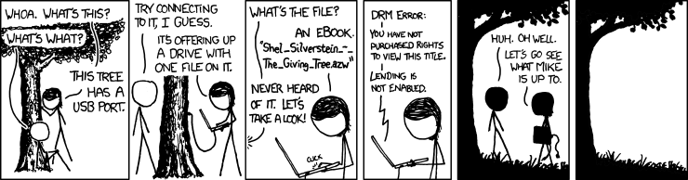
Internet procrastination break…

Slide 11
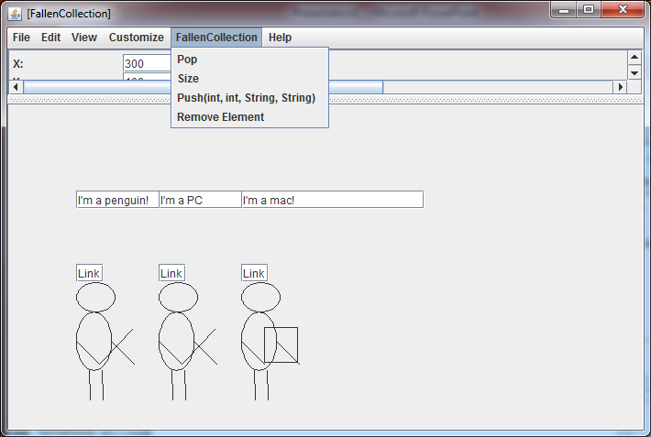
Fallen Avatars: Create a dynamic ordered collection which stores knights and /or the guard.

Slide 12
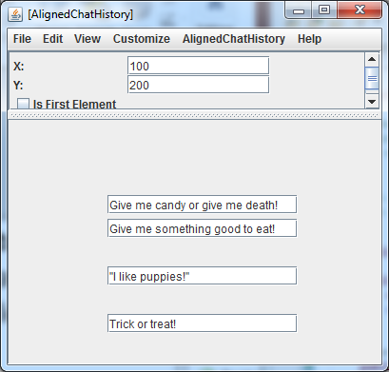
Aligned Movable Chat History: Create a subtype of the movable chat history that ensures its elements are left aligned.

Slide 13
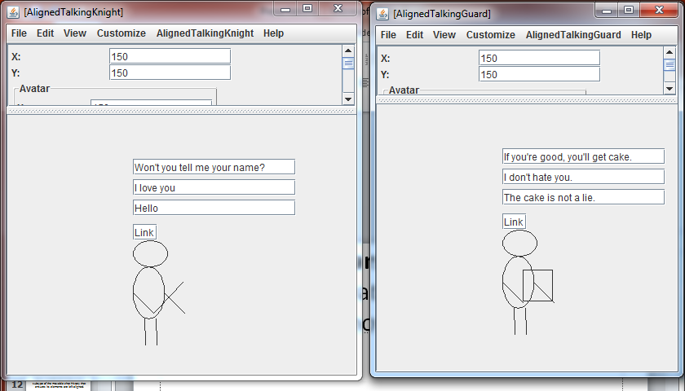
Movable Avatars with Aligned Chat History: Modify avatars with chat history to use aligned movable chat history.

Slide 14
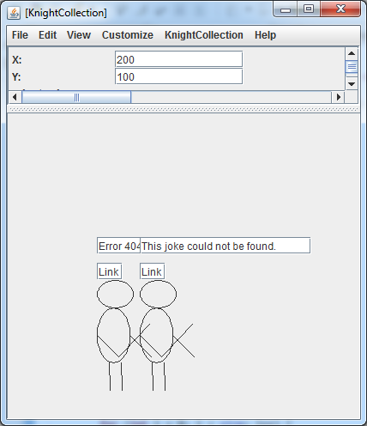
Movable Knights with Chat History: Modify marching knights with chat history to use movable knight avatars with aligned movable chat history.

Slide 15
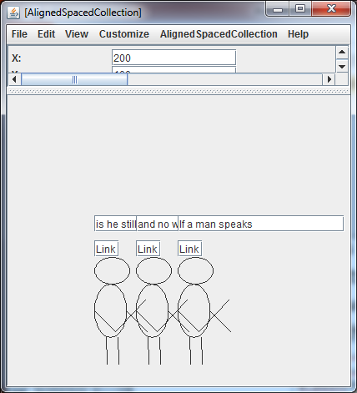
Aligned and Spaced Movable Knights with Chat History: Create a subtype of the Movable Knights with Chat History that bottom aligns the knights and spaces each knight some fixed distance apart.
avatars.AlignedSpacedCollection a = new avatars.AlignedSpacedCollection(200, 100);
a.push(0,0, "If a man speaks", "guard");
a.push(0,0,"and no woman hears him", "knight");//type here doesn't matter; they are all knights
a.push(0,0, "is he still wrong?", null);
ObjectEditor.edit(a);

Slide 16
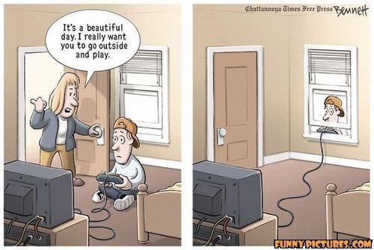

Slide 17
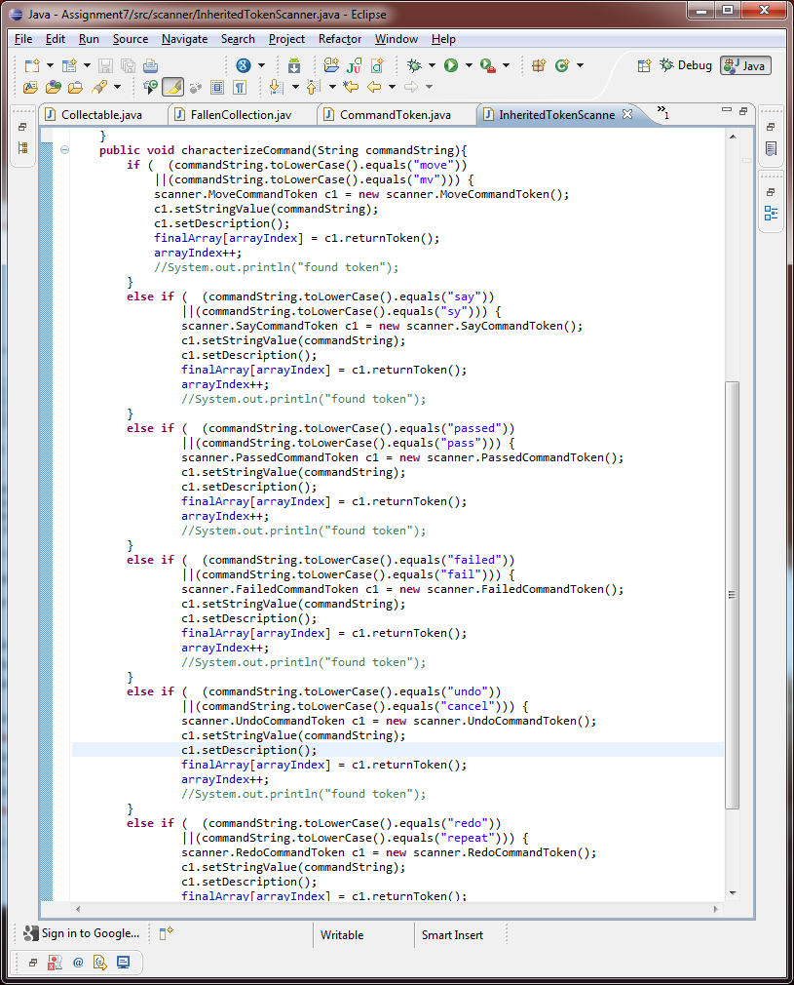
Allow a user to enter multiple words for the same command

Slide 18

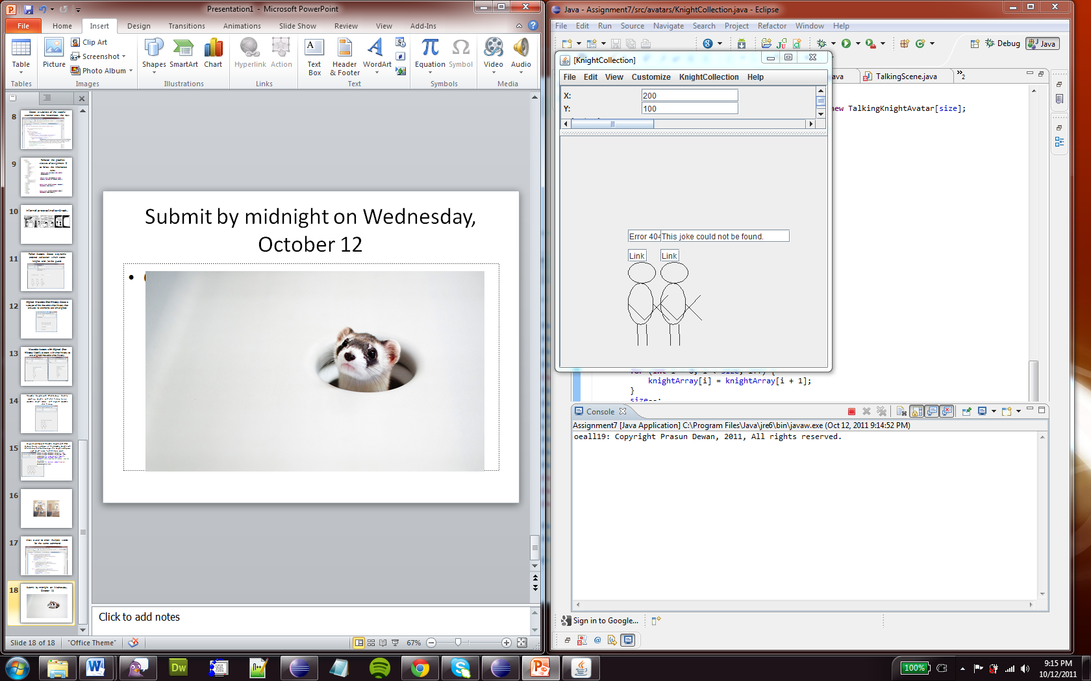
Submit by midnight on Wednesday, October 12

